Slide 1
Performance Testing
Using apache JMeter

Slide 2
What is Performance Testing
Performance Testing is defined as a type of Non-Functional software testing to ensure software applications will perform well under expected workload.
The goal of Performance Testing is not to find bugs but to eliminate performance bottlenecks.
The focus of Performance Testing is checking a software program's
Speed – determines application responds quickly
Scalability – maximum user software application can handle
Stability – if the application is stable under varying load
Performance Testing is popularly called "Perf Testing".

Slide 3
What are the types of performance testing
Load Testing – max user loads
Stress testing – Exceeds bottleneck identifying breaking point of an application
Endurance testing – software can handle expected load over the long period of time
Spike testing – sudden spike in users
Volume testing – large number of data is populated in the database and the overall software systems behaviour is monitores so the ojective is to check the software application performance under the varyinf database volume

Slide 4
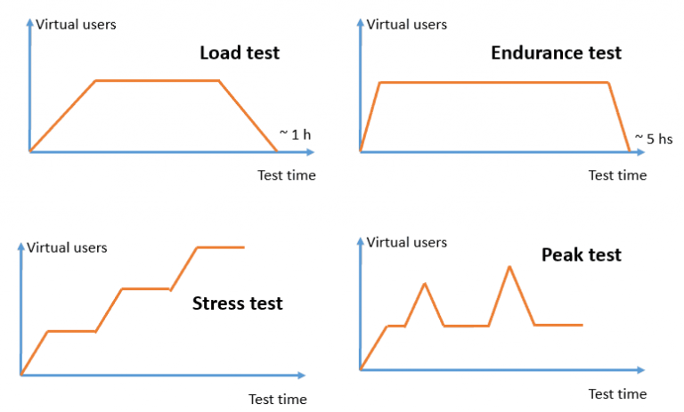
Some types performance testing Charts

Slide 5
What are the common performance Problem
Long load time – few seconds as possible
Poor response time – for user input output should be immediate
poor scalability – more users should able to use
Bottleneck – may be caused because of code or hardware issue
CPU utilization
Some Common performance bottlenecks are
memory utilization
network utilization
operating system limitations
disk usage

Slide 6
Performance Testing Metrics: Parameters Monitored
Processor Usage - an amount of time processor spends executing non-idle threads.
Memory use - amount of physical memory available to processes on a computer.
Disk time - amount of time disk is busy executing a read or write request.
Bandwidth - shows the bits per second used by a network interface.
Private bytes - number of bytes a process has allocated that can't be shared amongst other processes. These are used to measure memory leaks and usage.
Committed memory - amount of virtual memory used.

Slide 7
Performance Testing Metrics: Parameters Monitored
Response time - time from when a user enters a request until the first character of the response is received. Throughput-rate a computer or network receives requests per second.
Amount of connection pooling - the number of user requests that are met by pooled connections. The more requests met by connections in the pool, the better the performance will be.
Maximum active sessions - the maximum number of sessions that can be active at once.
Hit ratios - This has to do with the number of SQL statements that are handled by cached data instead of expensive I/O operations. This is a good place to start for solving bottlenecking issues.
Hits per second - the no. of hits on a web server during each second of a load test.
Thread counts - An applications health can be measured by the no. of threads that are running and currently active.

Slide 8
Examples of Performance Test cases
Verify response time is not more than 4 secs when 1000 users access the website simultaneously.
Verify response time of the Application Under Load is within an acceptable range when the network connectivity is slow
Check the maximum number of users that the application can handle before it crashes.
Check database execution time when 500 records are read/written simultaneously.
Check CPU and memory usage of the application and the database server under peak load conditions
Verify response time of the application under low, normal, moderate and heavy load conditions.

Slide 9




Some Performance Testing Tools

Slide 10
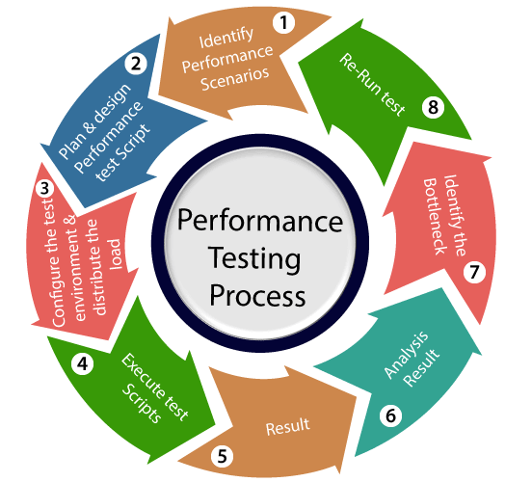
Performance Testing Life cycle

